Slide 1
Fast Exploration of Variable Precision Linear Kernels
¹ CEA, LIST, Grenoble, France
² Univ. Grenoble Alpes, Grenoble INP, TIMA, Grenoble, France
Emails: yves.Durand@cea.fr; tiago.trevisan-jost@univ-grenoble-alpes.fr
Supported by the ANR (French National Research Agency)

Slide 2
outline
Motivation for variable precision
Contribution
Experimental Results
Conclusion

Slide 3
outline
Motivation for variable precision
Contribution
Experimental Results
Conclusion

Slide 4

motivation
Main motivation is to increase scalability.
At compute node level, algebraic kernels are limited by available memory size
Modern computing kernels (solvers, eigensolvers,…) consume less memory at the price of stability
Solution to compensate the error is to increase precision (i.e. fractional size)
Precision increase should be fine tunable, dynamically configurable for an optimal usage of close memory
Numerical stability
→ efficiency
Memory footprint
→ System size

Slide 5
Use case in algebraic computation
VP is very effective for projective techniques (eg Conjugate Gradient) used for large problems
Low overhead in memory
It secures and accelerates convergence → enables parallelization, improves resolution of
non-hermitian problems, etc.
Quick drop of iteration count down to the minimum (~ diag size) when using moderate precision (<256 bits of mantissa) in classical examples
double

Slide 6
motivation
Precision control a key feature for numerical analysts
Explore suitable trade-offs between accuracy and execution time.
Problem: VP with current language support
IEEE formats have fixed sizes
Resort to libraries (MPFR, Boost)
Slowdown computation
No inherent compiler support
Other FP representations?
How to write code to explore accuracy in applications?
What is the impact of the precision on
Conjugate Gradient algorithm?
loop until accuracy is not met
precision = precision + 1
call CG with precision
calculate accuracy
Variable Precision (VP) Computing

Slide 7
STATE OF THE ART
Mixed-precision approach [Baboulin 2009]
Combine IEEE formats for speed and energy efficiency ✅
Hardware support ✅
Limiting number of types (16, 32, 64, 128 at most) ❌
Multi-precision Libraries (MPFR[Fousse 2007], GMP[Granlund 2016], etc.)
Flexibility (any number of mantissa bits) ✅
No hardware support ❌
Flytes [Anderson 2016]
Works with non-traditional formats ✅
Hardware Support ✅
Requires IEEE conversions (no high-precision support) ❌

Slide 8
outline
Motivation for variable precision
Contribution
Experimental Results
Conclusion

Slide 9
outline
Motivation for variable precision
Contribution
Experimental Results
Conclusion

Slide 10
contribution
Generalization of mixed-precision to arbitrary/variable precision
Make variable precision exploration
Easier
With high-precision representations
Faster than current solutions
Performance-oriented language
Kernel source code must be unique
(no code replication)
A variable-precision implementation
similar as possible to its original reference
Boost for Multi-precision
Julia
Python
MPFR Library
Impact of varying the precision of linear algebra kernels
(impact on stability, performance)

Slide 11
Contribution
Propose a C type extension to represent variable precision FP arithmetic
vpfloat<type, attribute1, attribute2, …>
LLVM IR extension to handle generic FP types
Leverage LLVM classical optimizations
Backend code generators for software and hardware targets
MPFR (Software backend) and UNUM Type 1 (HW Backend)
WIP: Our current target is extendable IEEE
Works with non-traditional formats ✅
Hardware and Software Support ✅
Full integration with an industry-level compiler ✅

Slide 12
Compilation flow
LLVM
Frontend
vpfloat<mpfr,...>
vpfloat<unum,...>
Middle-end
vpfloat<mpfr,…>
vpfloat<unum,…>
Type System
LLVM IR
(Optimizations)
Backend
vpfloat<mpfr,...>
vpfloat<unum,...>
Backend
MPFR Library
RISC-V ISA Extension for the UNUM Format
[Bocco et al. 2019]
Bocco, et al.. 2019. SMURF: Scalar Multiple-precision Unum Risc-V Floating-point Accelerator for Scientific Computing. In Proceedings of the Conference for Next Generation Arithmetic. 1–8.
Fousse, et al. MPFR: A Multiple-precision Binary Floating-point Library with Correct Rounding. ACM Trans. Math. Softw. 33, 2, Article 13 (June 2007)
John L. Gustafson. 2017. The end of error: UNUM computing. 416 pages.

Slide 13
Compilation flow
LLVM
Frontend
vpfloat<mpfr,...>
vpfloat<unum,...>
Middle-end
vpfloat<mpfr,…>
vpfloat<unum,…>
Type System
LLVM IR
(Optimizations)
Backend
vpfloat<mpfr,...>
vpfloat<unum,...>
Backend
MPFR Library
RISC-V ISA Extension for the UNUM Format
[Bocco et al. 2019]

Slide 14
Language and frontend
Propose a C type extension to represent variable-precision FP arithmetic
vpfloat<type, attribute1, attribute2, …>
UNUM [Gustafson 2017]: vpfloat<unum, ess, fss, size>
MPFR [Fousse 2007]: vpfloat<mpfr, exponent, mantissa>
Constants
Variables
Static types
Types with attributes only known at runtime
Fousse, et al. MPFR: A Multiple-precision Binary Floating-point Library with Correct Rounding. ACM Trans. Math. Softw. 33, 2, Article 13 (June 2007)
John L. Gustafson. 2017. The end of error: UNUM computing. 416 pages.

Slide 15
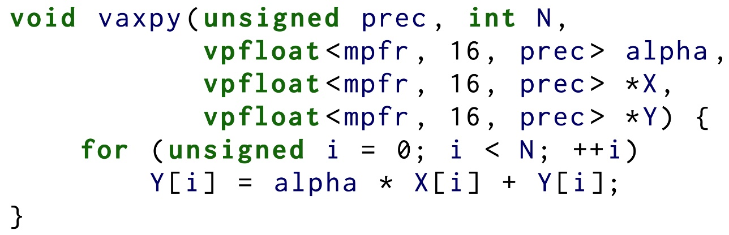
MPFR TYPES
vpfloat<mpfr, exponent, mantissa>
Fousse, et al. MPFR: A Multiple-precision Binary Floating-point Library with Correct Rounding. ACM Trans. Math. Softw. 33, 2, Article 13 (June 2007)

Slide 16
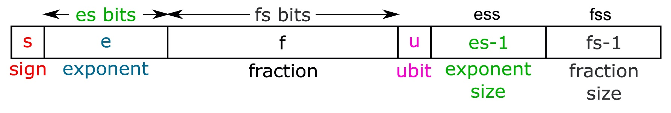
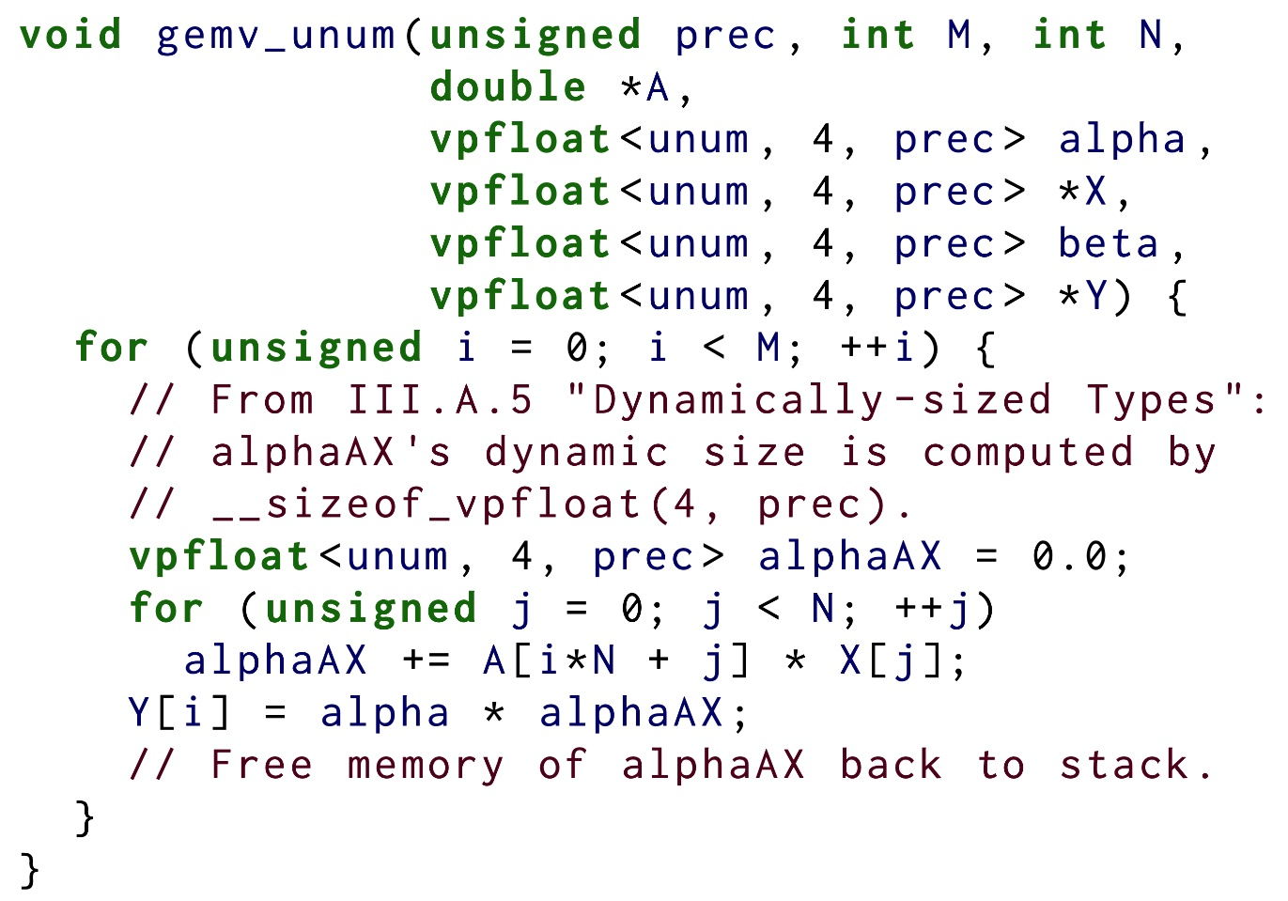
UNUM TYPES
vpfloat<unum, ess, fss, size>
UNUM Type 1
Simplified ISA of Bocco et al.
A. Bocco, Y. Durand, and F. De Dinechin, ‘‘SMURF: Scalar multipleprecision unum risc-v floating-point accelerator for scientific computing,’’ in Proceedings of CoNGA, 2019, pp. 1--8.
John L. Gustafson. 2017. The end of error: UNUM computing. 416 pages.

Slide 17
Compilation flow
LLVM
Frontend
vpfloat<mpfr,...>
vpfloat<unum,...>
Checkout our paper at CGO 2021:
Seamless Compiler Integration of Variable Precision Floating-Point Arithmetic
Middle-end
vpfloat<mpfr,…>
vpfloat<unum,…>
Type System
LLVM IR
(Optimizations)
Backend
vpfloat<mpfr,...>
vpfloat<unum,...>
Backend
MPFR Library
RISC-V ISA Extension for the UNUM Format
[Bocco et al. 2019]
Bocco, et al.. 2019. SMURF: Scalar Multiple-precision Unum Risc-V Floating-point Accelerator for Scientific Computing. In Proceedings of the Conference for Next Generation Arithmetic. 1–8.
Fousse, et al. MPFR: A Multiple-precision Binary Floating-point Library with Correct Rounding. ACM Trans. Math. Softw. 33, 2, Article 13 (June 2007)
John L. Gustafson. 2017. The end of error: UNUM computing. 416 pages.

Slide 18
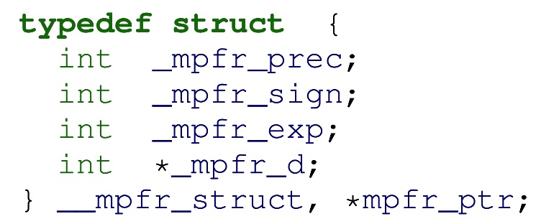
MPFR Backend
Transform vpfloat → MPFR
vpfloat<mpfr, exponent, mantissa>
f{add,sub,mul,div} vpfloat<mpfr,...>
. . .
mpfr_{add,sub,mul,div}
...
signed
unsigned
double
float

Slide 19
UNUM backend
RISC-V ISA Extension for the UNUM Format [Bocco et al. 2019]
Multiple precision levels (up to 512 bits)
Byte-aligned FP values in memory
ess and fss fields → status registers
WGP (Working G-layer Precision): Operating precision
MBB (Memory Byte Budge): Num Bytes read/written memory
Bocco, et al.. 2019. SMURF: Scalar Multiple-precision Unum Risc-V Floating-point Accelerator for Scientific Computing. In Proceedings of the Conference for Next Generation Arithmetic. 1–8.
John L. Gustafson. 2017. The end of error: UNUM computing. 416 pages.

Slide 20
outline
Motivation for variable precision
Contribution
Experimental Results
Conclusion

Slide 21
outline
Motivation for variable precision
Contribution
Experimental Results
Conclusion

Slide 22
Experiments - performance
Beneﬁts of Language and Compiler Integration
vpfloat<mpfr, …> vs. Boost Multi-precision Library
Both generate MPFR code
Extended precision
Polybench Benchmark suite [Pouchet et al. 2012]
RAJAPerf (https://github.com/LLNL/RAJAPerf)
Six variants (3 Sequentials, 3 OpenMPs)
Machine
Intel Xeon E5-2637v3 with 128GB of RAM, for a total of 8 cores and 16 hardware threads.
Polybench
Average speedup of 1.80× over Boost library for multiprecision
RAJAPerf
Sequential: 1.67× over Boost library for multiprecision
Parallel (OpenMP): 7.62× over Boost library for multiprecision
How can we achieve these speeds?
Tight integration with LLVM allows better exploration of classical optimizations (constant folding, inlining, common subexpression elimination, etc)
Our solution scales much better than Boost in a multi-threaded environment.
Reduction of memory accesses and cache misses
Boost transforms many compute-bound kernels into memory-bound ones
Louis-Noël Pouchet et al. 2012. PolyBench: The polyhedral benchmark suite. http://www.cs.ucla.edu/pouchet/software/polybench.
T. Grosser, et al. ‘‘Polly -- polyhedral optimization in LLVM,’ in IMPACT 2011
‘‘Rajaperf.’’ [Online]. Available: https://github.com/LLNL/RAJAPerf

Slide 23
Experiments - performance
Beneﬁts of HW support
vpfloat<unum, …> vs. vpfloat<mpfr, …>
Polybench Benchmark Suite [Pouchet et al. 2012]
Hardware support vs. Software support
Extended precision
RISC-V Rocket processor [Asanovic 2016] connected to the UNUM [Bocco 2019] coprocessor
Speedup of 18.03× when using –O3
and 27.58× when using -O3 + Polly
Louis-Noël Pouchet et al. 2012. PolyBench: The polyhedral benchmark suite. http://www.cs.ucla.edu/pouchet/software/polybench.
T. Grosser, et al. ‘‘Polly -- polyhedral optimization in LLVM,’ in IMPACT 2011
A. Bocco, et al. , ‘‘SMURF: Scalar multipleprecision unum risc-v floating-point accelerator for scientific computing,’’ in CoNGA 2019
K. Asanovi´c, et al., ‘‘The Rocket Chip Generator,’’ EECS Department, University of California, Berkeley, Technical Report

Slide 24
Linear Algebra Kernels
vpfloat with runtime attributes
Great exploration tool for precision-awareness
Four variants of CG
Original (Hestenes and Stiefel algorithm)
Preconditioned CG (jacobi preconditioner)
Pipelined CG
BiCG
What is the impact of the precision on
Conjugate Gradient algorithm?
M. R. Hestenes, E. Stiefel, et al. “Methods of conjugate gradients for solving linear systems”. In: Journal of research of the National Bureau of Standards 49.6 (1952), pp. 409–436
P. Ghysels and W. Vanroose. “Hiding global synchronization latency in the preconditioned Conjugate Gradient algorithm”. In: Parallel Computing. 7th Workshop on Parallel Matrix Algorithms and Applications 40.7 (July 2014), pp. 224–238. url: https://www.sciencedirect.com/science/ article/pii/S0167819113000719
Y. Saad. Iterative Methods for Sparse Linear Systems. Other Titles in Applied Mathematics. Society for Industrial and Applied Mathematics, Jan. 2003. isbn: 978-0-89871-534-7. doi: 10.1137/1.9780898718003.

Slide 25
Conjugate gradient
Requirements
Precision-generic implementation
Respect maximum tolerance (threshold)
Stopping condition
Threshold: 10⁻¹⁰

Slide 26
Conjugate gradient
BLAS Libraries
Different types
Double (OpenBLAS)
Long double (FP80)
FP 128
vpfloat<mpfr, ...> (from 150 to 2000 bits, step = 50)
40 squared SPD matrices from Matrix Market
Between 132 to 5489

Slide 27
Conjugate gradient
High precision improve significantly convergence
How much? Depend on Condition number, and problem size
Preconditioned CG significantly improves convergence.

Slide 28
Conjugate gradient
Pipelined CG
Is more unstable [Carson 2018] than other variants
Other implementations were proposed [Cools 2019]
Observation: High precision → Compensate round-off errors → reach stability
E. C. Carson, M. Rozložník, Z. Strakoš, P. Tichý, and M. Tůma. “The Numerical Stability Analysis of Pipelined Conjugate Gradient Methods: Historical Context and Methodology”. In: SIAM Journal on Scientiﬁc Computing 40.5 (2018), A3549–A3580.
S. Cools, J. Cornelis, P. Ghysels, and W. Vanroose. “Improving strong scaling of the Conjugate Gradient method for solving large linear systems using global reduction pipelining”.
S. Cools, J. Cornelis, and W. Vanroose. “Numerically Stable Recurrence Relations for the Communication Hiding Pipelined Conjugate Gradient Method”. In: IEEE Transactions on Parallel and Distributed Systems 30.11 (2019), pp. 2507–2522.

Slide 29
Conjugate gradient - Performance
Comparing with Boost Multi-precision
At least 30% faster
When compared to Julia ( > 9x )
Possibility of exploring HW support

Slide 30
outline
Motivation for variable precision
Contribution
Experimental Results
Conclusion

Slide 31
outline
Motivation for variable precision
Contribution
Experimental Results
Conclusion

Slide 32
conclusion
Language and Compiler support is extensible
Legacy code compatibility
With hardware support
Still, better performance than baseline
Initial experimental results (more to come)
Iterative projective method
Perspectives?
Hardware support: Could we compete with CG (Standard BLAS) in terms of execution time?
New applications for variable precision

Slide 33
any Questions?
Yves Durand
yves.durand@cea.fr
Tiago Trevisan Jost
tiago.trevisan-jost@univ-grenoble-alpes.fr
This work was partially funded by the French Agence nationale de la recherche (ANR) for project IMPRENUM under grant n°ANR-18-CE46-0011.
This presentation and recording belong to the authors. No distribution is allowed without the authors' permission
Notes:
For any quetions, do not hesitate to contact me.

Slide 34
Language and frontend
Static types (FP attributes known at compile time)
Works similar to regular FP types
Easy control of exponent and mantissa, size and
memory allocation.
Dynamic types (FP attributes known only at runtime)
Requires dynamic-sized stack allocation
Captures the expressiveness needed by numerical analysts
Fousse, et al. MPFR: A Multiple-precision Binary Floating-point Library with Correct Rounding. ACM Trans. Math. Softw. 33, 2, Article 13 (June 2007)
John L. Gustafson. 2017. The end of error: UNUM computing. 416 pages.

